Slide 1



Git — version control system
Alex Prut (Alexandru Pruteanu)
http://alexprut.com

Slide 2
Table of contents
About (architecture, requirements, …)
Git Basics (branches, remote, commit, …)
Advanced Topics (rebase, stashing,…)
Demo (how to contribute to an open-source project)

Slide 3
Images and Text are not mine!
Thanks to https://git-scm.com/doc

Slide 4
The Problem

Slide 5
You want to write some code with a group of people
You find commented code within files
You send an email to your peer with all the project files
You use telegram to send files
You cancel files and can’t recover them
You don’t know what was the yesterday version of the files!!!

Slide 6


Solution!
Dropbox
Google Drive
…

Slide 7

The Problem

Slide 8
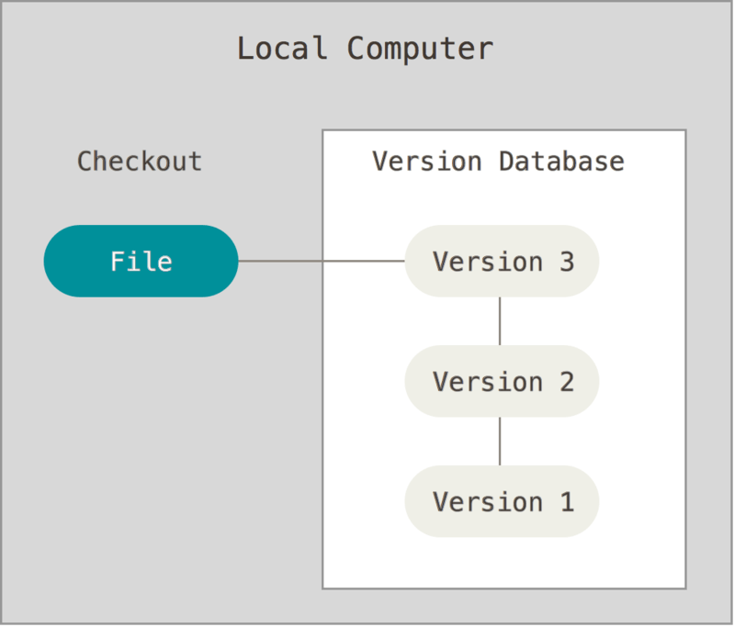
Mhh, solution!!!
Local version control system

Slide 9
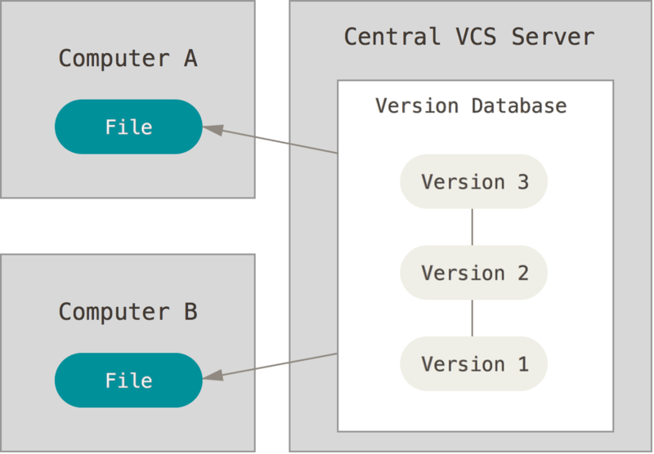
Mhh, solution!!!
Central version control system

Slide 10
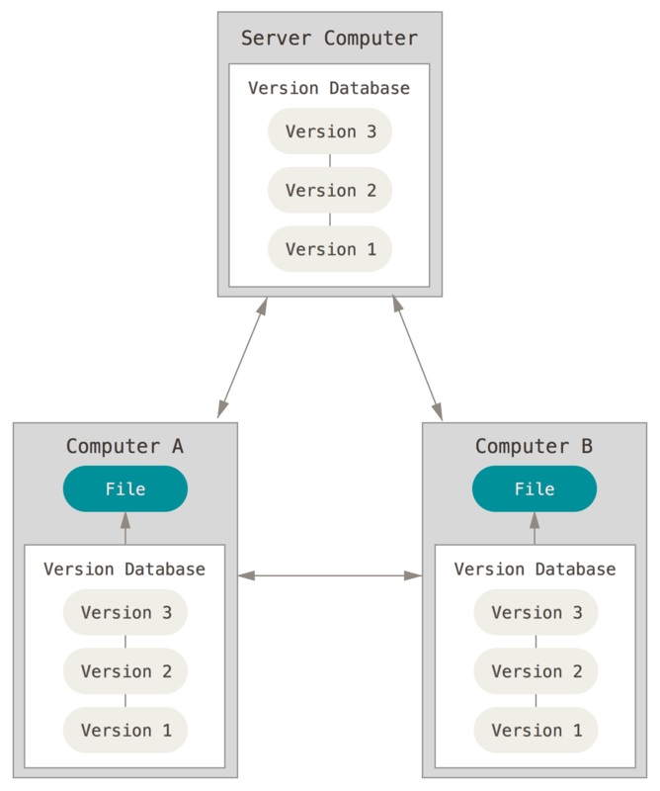
Mhh, solution!!!
Distributed version control system (Git, born in 2005)

Slide 11



Git services
https://gitlab.com
https://github.com
https://bitbucket.org

Slide 12
Goals of the new system
Speed
Simple design
Strong support for non-linear development (thousands of parallel branches)
Fully distributed
Able to handle large projects like the Linux kernel efficiently (speed and data size)

Slide 13
1. About

Slide 14

Branching and Merging
Frictionless Context Switching
Role-Based Codelines
Feature Based Workflow
Disposable Experimentation

Slide 15
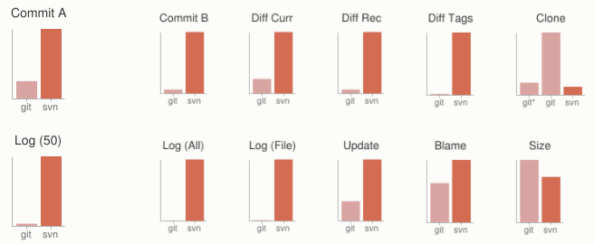
Small and Fast
Benchmark: Git vs. SVN

Slide 16
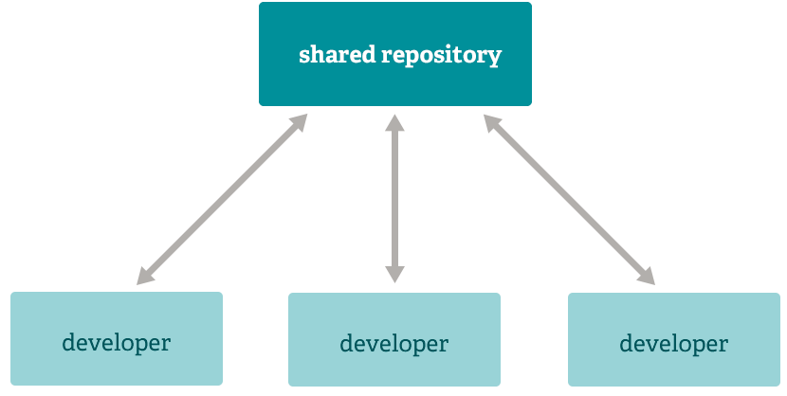
Distributed
Multiple Backups
Any Workflow

Slide 17
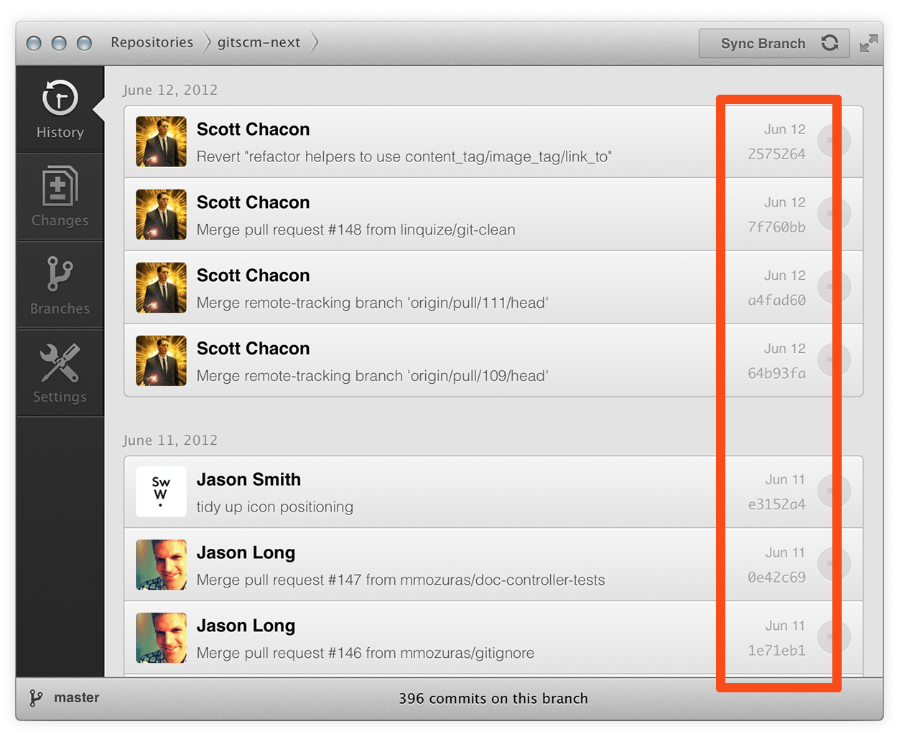
Data Assurance
The data model that Git uses ensures the cryptographic integrity of every bit of your project

Slide 18
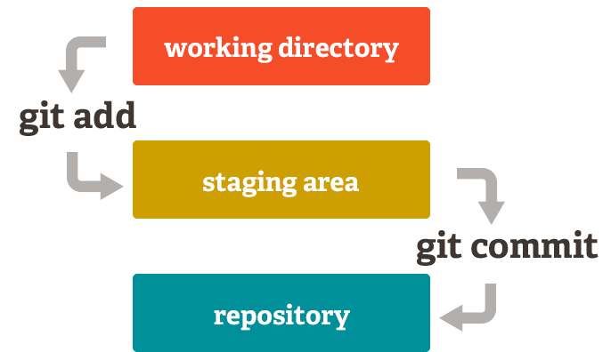
Staging Area

Slide 19
Open-Source
Free and Open Source
GPLv2
https://github.com/git/git

Slide 20
2. Git Basics

Slide 21
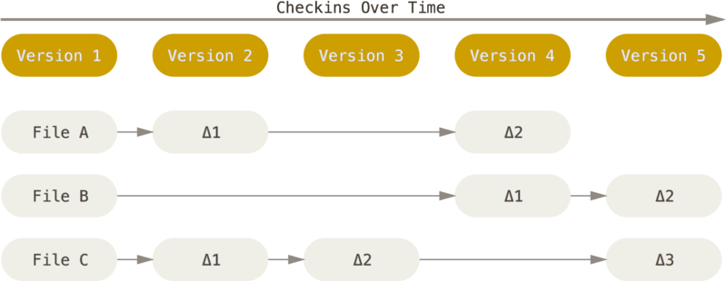
Snapshots, Not Differences

Slide 22
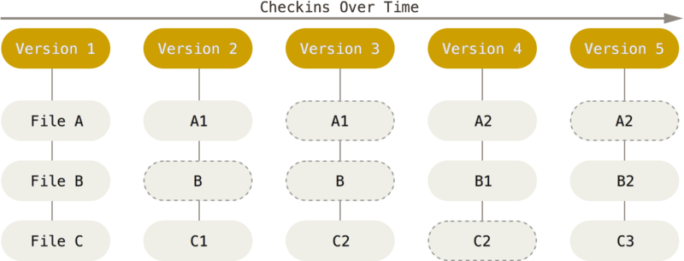
Snapshots, Not Differences

Slide 23
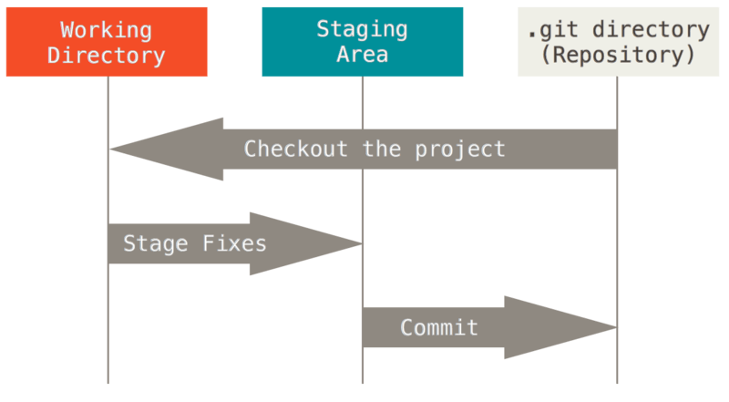
The Three States
Modified, Staged, Committed

Slide 24
The Command Line
The command line is the only place you can run all Git commands!!!
We will expect you to know how to open Terminal in Mac or Command Prompt or Powershell in Windows

Slide 25
Installing Git
Kind of trivial
https://git-scm.com/book/en/v2/Getting-Started-Installing-Git
Linux, Mac, Windows

Slide 26
First-Time Git Setup
a few things to customize your Git environment
3 of configuration levels, you can override
$ git config --global user.name "John Doe"
$ git config --global user.email johndoe@example.com
$ git config —list
$ git help <verb>

Slide 27
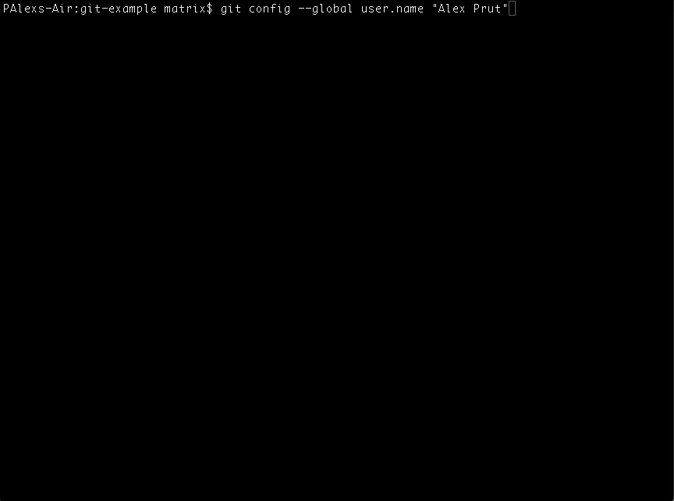

Slide 28
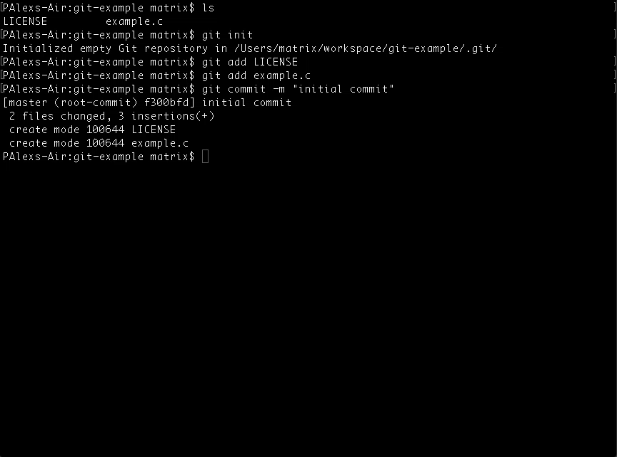

Slide 29
Basic Git workflow
You modify files in your working directory.
You stage the files, adding snapshots of them to your staging area.
You do a commit, which takes the files as they are in the staging area and stores that snapshot permanently to your Git directory.

Slide 30
Getting a Git Repository
Initializing a Repository in an Existing Directory
$ git init
$ git add *.c
$ git add LICENSE
$ git commit -m 'initial project version’
Cloning an Existing Repository
$ git clone https://github.com/libgit2/libgit2

Slide 31
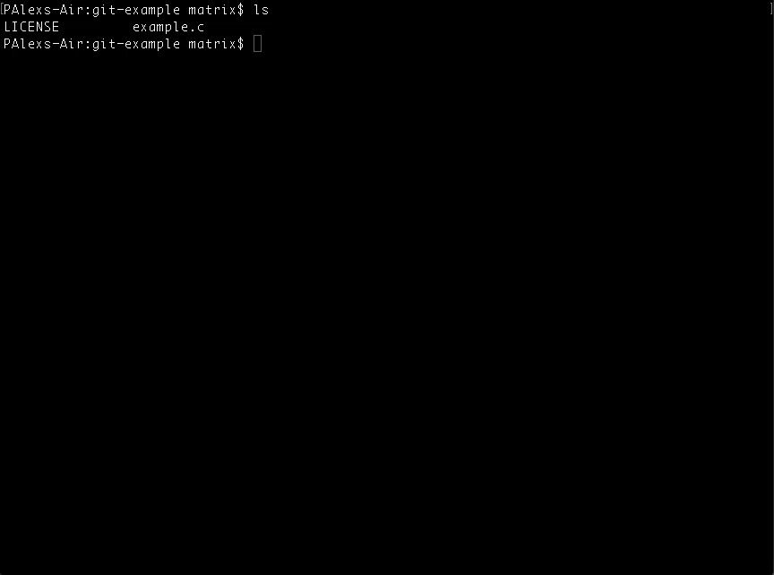

Slide 32
Recording Changes to the Repository
File in your working directory can be in one of two states: tracked or untracked
Tracked: files are files that were in the last snapshot; they can be:
unmodified
modified
staged
Untracked: files are everything else – any files in your working directory that were not in your last snapshot

Slide 33
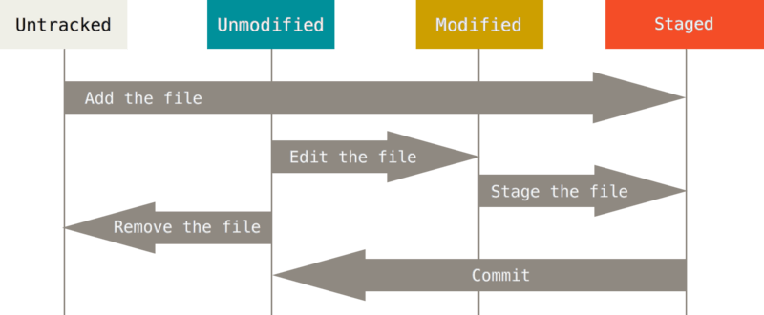
Lifecycle of the status of your files

Slide 34
Basic Commands
Checking the Status of Your File
$ git status
Tracking New Files
$ git add
Ignoring Files
$ cat .gitignore
Viewing Your Staged and Unstaged Changes
$ git diff
Removing Files
$ git rm PROJECTS.md
Committing Your Changes
$ git commit -m “message example here”

Slide 35


Slide 36
Viewing the Commit History
this command lists each commit with its SHA-1 checksum
$ git log
$ git log -p --stat
$ git log --graph

Slide 37


Slide 38
Undoing Things
$ git commit --amend
$ git checkout -- <file>

Slide 39
Working with Remotes
Showing Your Remotes
$ git remote -v
$ git remote add <shortname> <url>
to get data from your remote projects
$ git fetch [remote-name]
It’s important to note that the git fetch command only downloads the data to your local repository – it doesn’t automatically merge it with any of your work or modify what you’re currently working on
command to automatically fetch and then merge that remote branch into your current branch, generally fetches data from the server you originally cloned from and automatically tries to merge it into the code you’re currently working on
$ git pull
This command works only if you cloned from a server to which you have write access
$ git push origin master

Slide 40
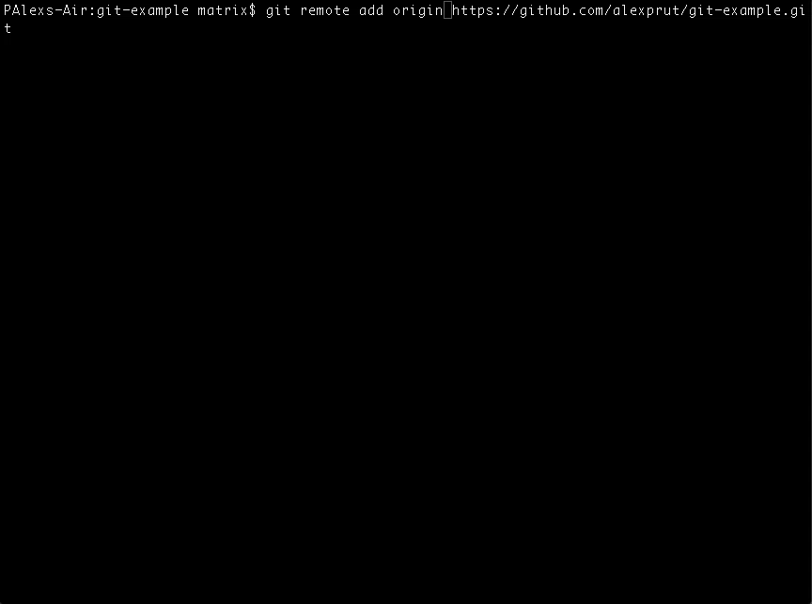

Slide 41
Tagging
Git uses two main types of tags:
lightweight
annotated
A lightweight tag is very much like a branch that doesn’t change – it’s just a pointer to a specific commit
Annotated tags, however, are stored as full objects in the Git database. They’re checksummed; contain the tagger name, email, and date; have a tagging message; and can be signed and verified with GNU Privacy Guard (GPG)
$ git tag
$ git tag -a v1.4 -m "my version 1.4”
$ git checkout -b [branchname] [tagname]

Slide 42
Summary
At this point, you can do all the basic local Git operations – creating or cloning a repository, making changes, staging and committing those changes, and viewing the history of all the changes the repository has been through. Next, we’ll cover Git’s killer feature: its branching model.

Slide 43
Branching

Slide 44
Branches in a Nutshell
Branching means you diverge from the main line of development and continue to do work without messing with that main line
Git encourages workflows that branch and merge often
When you make a commit, Git stores a commit object that contains a pointer to the snapshot of the content you staged. This object also contains the author’s name and email, the message that you typed, and pointers to the commit or commits that directly came before this commit (its parent or parents): zero parents for the initial commit, one parent for a normal commit, and multiple parents for a commit that results from a merge of two or more branches

Slide 45
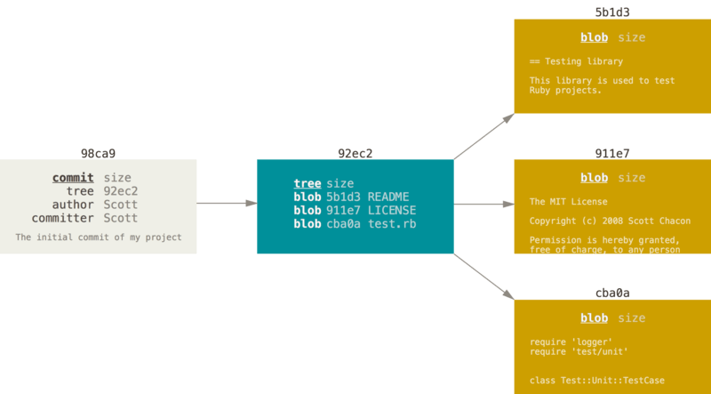
A commit and its tree

Slide 46
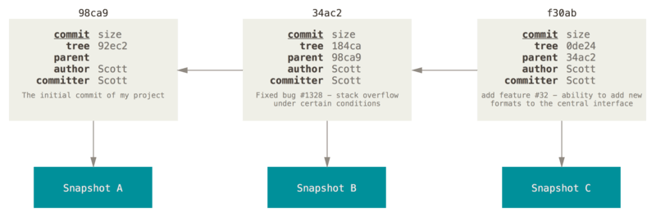
Commits and their parents
A branch in Git is simply a lightweight movable pointer to one of these commits
As you start making commits, you’re given a master branch that points to the last commit you made. Every time you commit, it moves forward automatically.

Slide 47


Slide 48
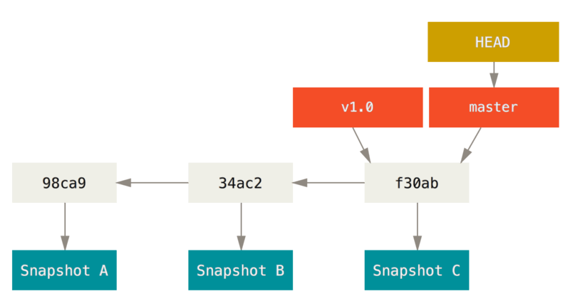
A branch and its commit history

Slide 49
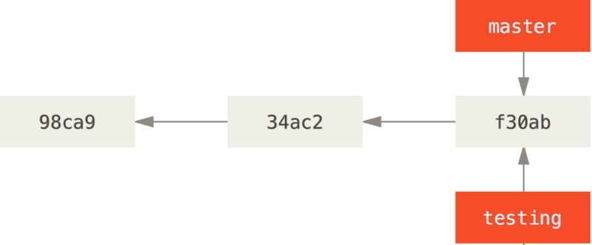
Creating a New Branch
$ git branch testing

Slide 50
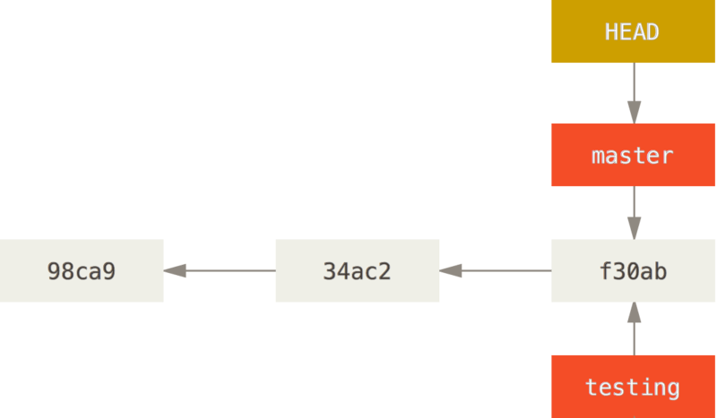
How does Git know what branch you’re currently on?
It keeps a special pointer called HEAD

Slide 51
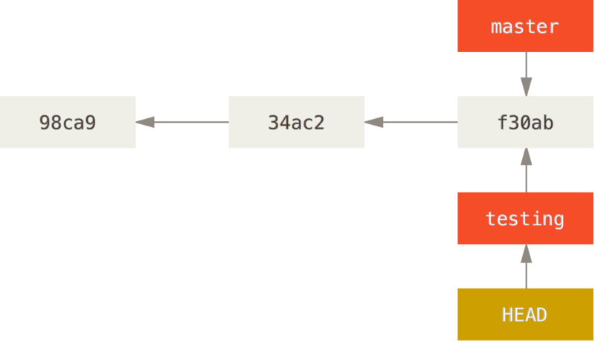
Switching Branches
$ git checkout testing

Slide 52
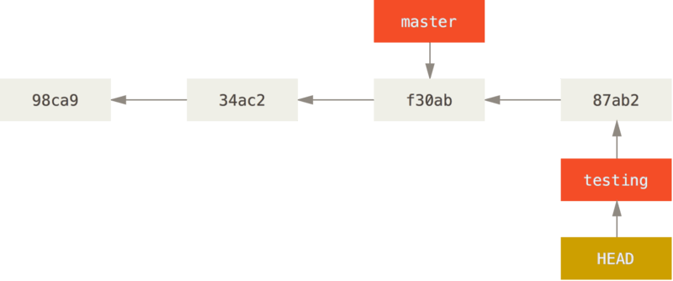
The HEAD branch moves forward when a commit is made

Slide 53
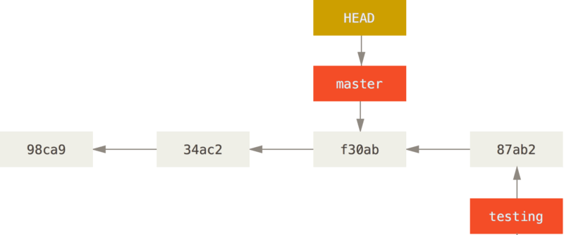
Change Branch
$ git checkout master

Slide 54


Slide 55
Change Branch
That command did two things. It moved the HEAD pointer back to point to the master branch, and it reverted the files in your working directory back to the snapshot that master points to. This also means the changes you make from this point forward will diverge from an older version of the project

Slide 56
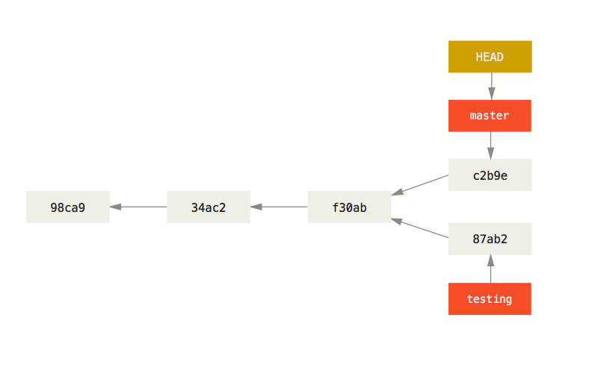
Divergent history

Slide 57
Divergent history
Because a branch in Git is in actuality a simple file that contains the 40 character SHA-1 checksum of the commit it points to, branches are cheap to create and destroy. Creating a new branch is as quick and simple as writing 41 bytes to a file (40 characters and a newline)

Slide 58
Merging

Slide 59
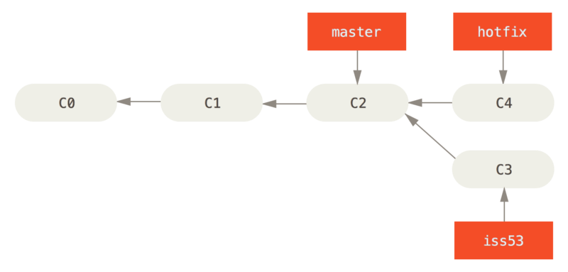
Fast-forward merge

Slide 60
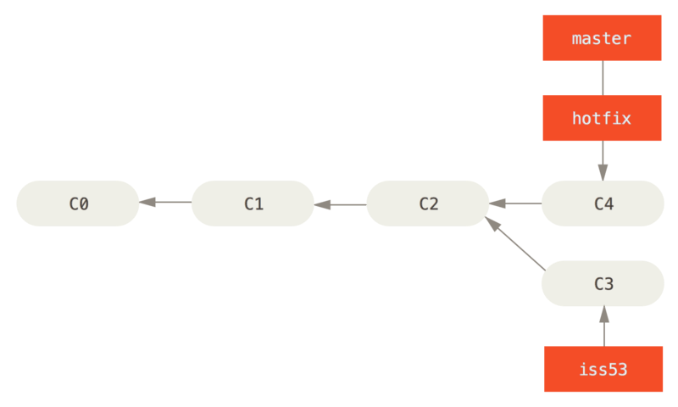
Fast-forward merge

Slide 61
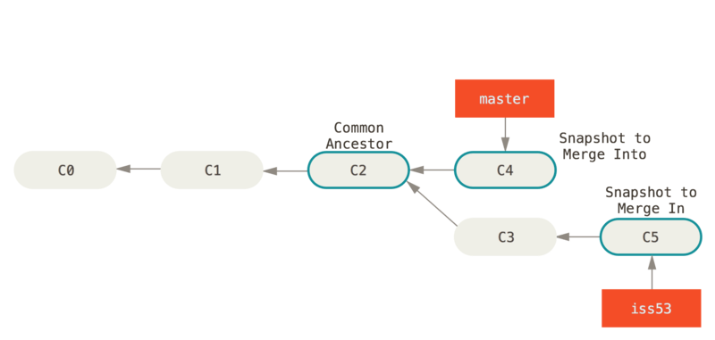
Three-way merge
Instead of just moving the branch pointer forward, Git creates a new snapshot that results from this three-way merge and automatically creates a new commit that points to it

Slide 62
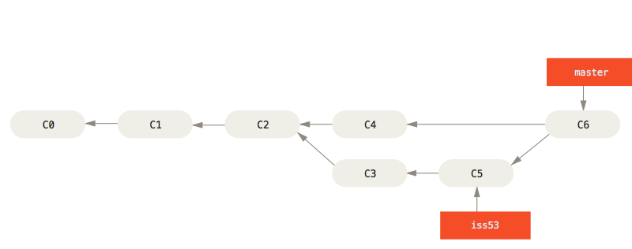
Three-way merge

Slide 63
Merge Conflicts
If you changed the same part of the same file differently in the two branches you’re merging together, Git won’t be able to merge them cleanly
It has paused the process while you resolve the conflict. If you want to see which files are unmerged at any point after a merge conflict, you can run git status:

Slide 64
Merge Conflicts
Conflict-resolution markers
<<<<<<< HEAD:index.html
<div id="footer">contact : email.support@github.com</div>
=======
<div id=“footer">
please contact us at support@github.com
</div>
>>>>>>> iss53:index.html
Confirm solved conflicts
$ git commit

Slide 65
Branching Workflows

Slide 66
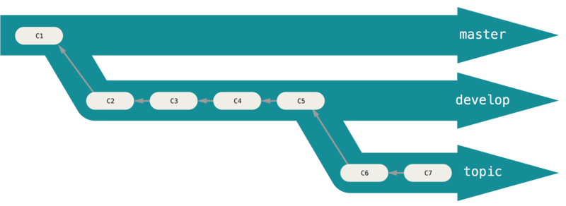
Long-Running Branches
Code that is entirely stable in their master branch
The idea is that your branches are at various levels of stability

Slide 67
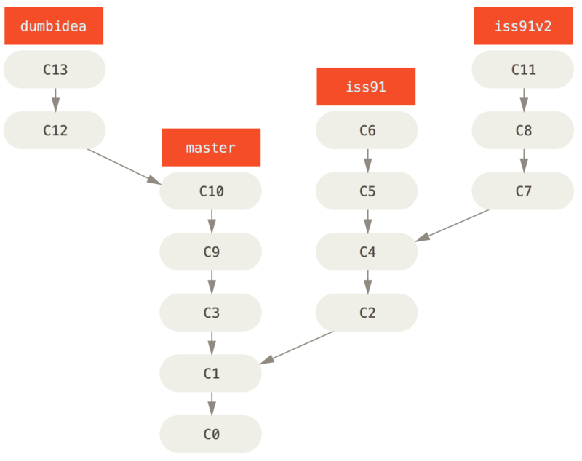
Topic Branches
Topic branches, however, are useful in projects of any size. A topic branch is a short-lived branch that you create and use for a single particular feature or related work

Slide 68
Remote
Remote-tracking branches are references to the state of remote branche
They take the form (remote)/(branch)
$ git remote add upstream https://github.com/ORIGINAL_OWNER/ORIGINAL_REPOSITORY.git

Slide 69
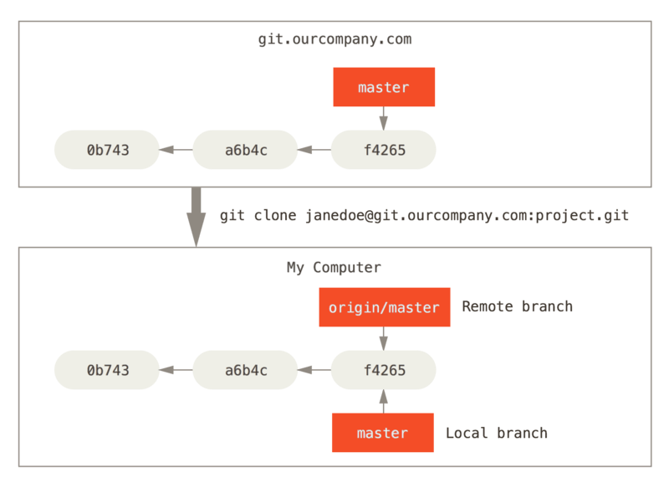
Remote

Slide 70
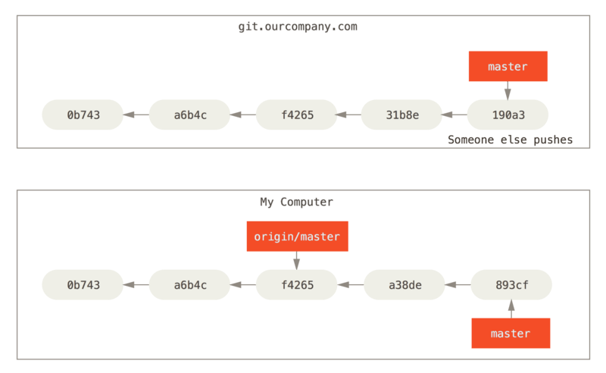
Remote

Slide 71
Tracking Branches
Checking out a local branch from a remote-tracking branch automatically creates what is called a “tracking branch” (and the branch it tracks is called an “upstream branch”). Tracking branches are local branches that have a direct relationship to a remote branch. If you’re on a tracking branch and type git pull, Git automatically knows which server to fetch from and branch to merge into.
$ git checkout --track origin/serverfix
git pull which is essentially a git fetch immediately followed by a git merge in most cases.

Slide 72
Rebasing
There are two main ways to integrate changes from one branch into another: the merge and the rebase
With the rebase command, you can take all the changes that were committed on one branch and replay them on another one.

Slide 73
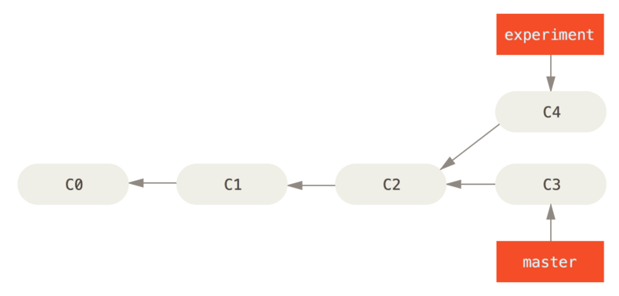
Rebase

Slide 74
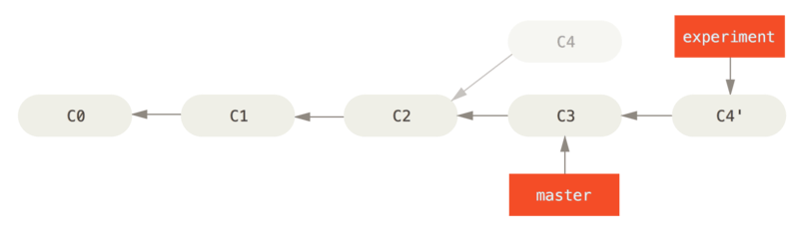
Rebase

Slide 75
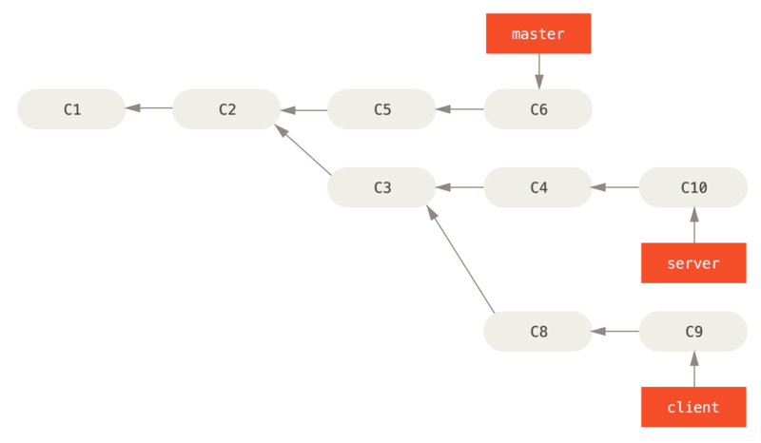
Complex Rebase
$ git rebase --onto master server client
Do not rebase commits that exist outside your repository.!!!

Slide 76
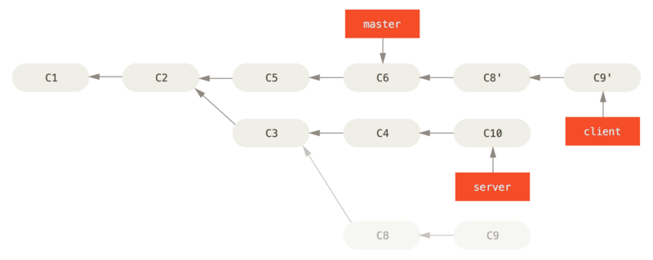
Complex Rebase
$ git rebase --onto master server client
Do not rebase commits that exist outside your repository.!!!

Slide 77
3. Advanced Topics

Slide 78
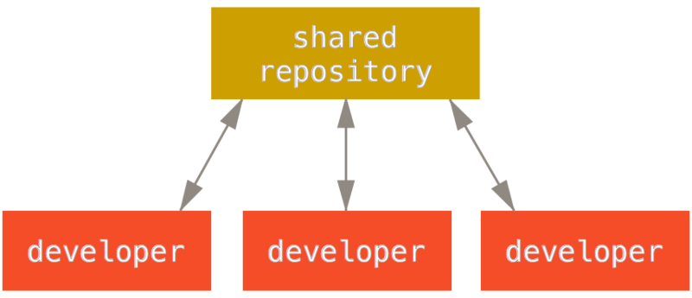
Distributed Workflows

Slide 79
Integration-manager workflow
The project maintainer pushes to their public repository.
A contributor clones that repository and makes changes.
The contributor pushes to their own public copy.
The contributor sends the maintainer an email asking them to pull changes.
The maintainer adds the contributor’s repo as a remote and merges locally.
The maintainer pushes merged changes to the main repository.

Slide 80
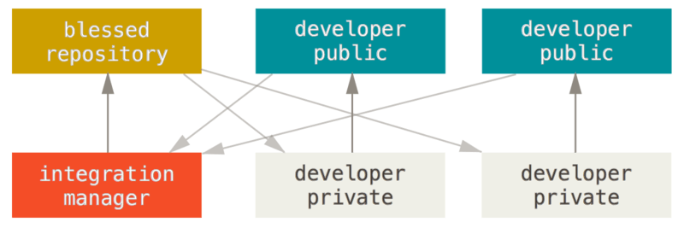
Integration-manager workflow

Slide 81
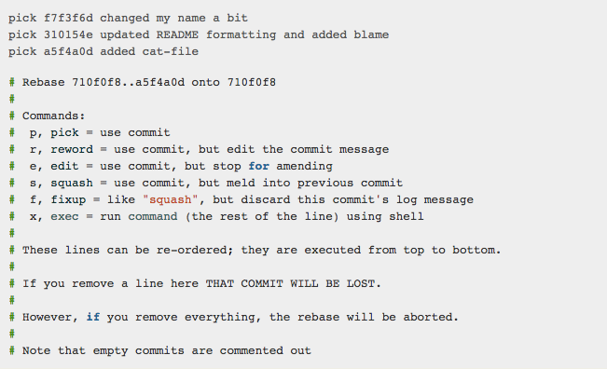
Rewriting History
Interactive rebase tool
$ git rebase -i HEAD~3

Slide 82
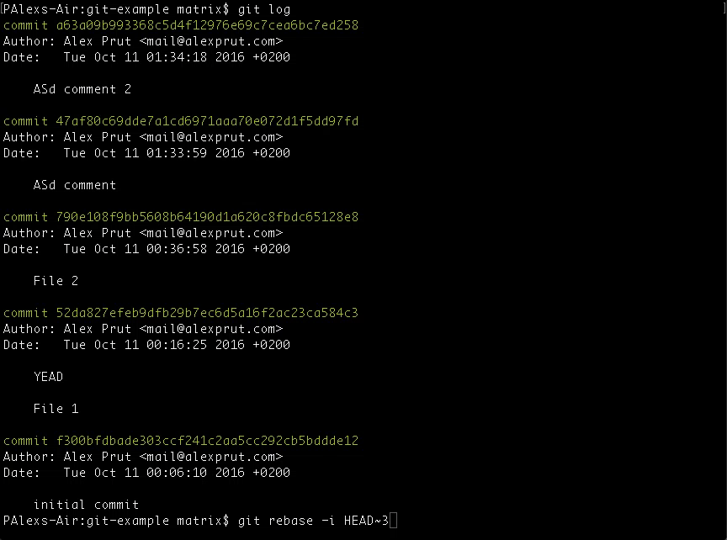

Slide 83
Stashing
store (something) safely and secretly in a specified place
$ git stash -u
$ git stash pop

Slide 84
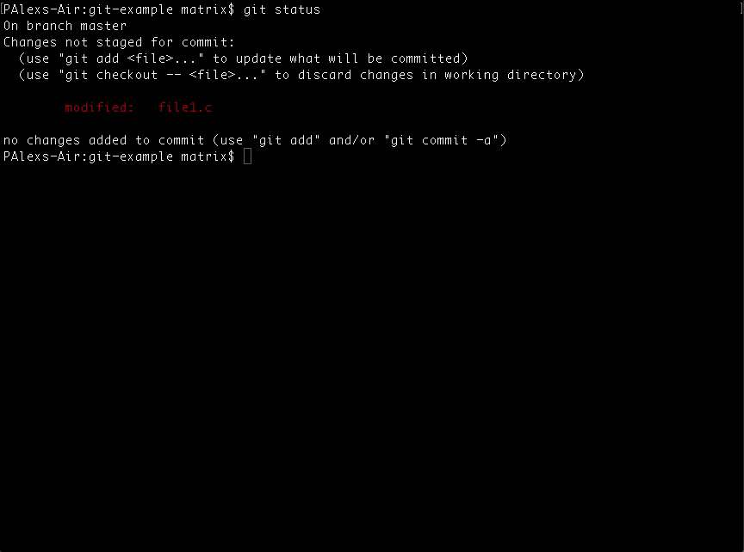

Slide 85
Submodules
Git repository inside another git repository
No time to explain sorry :(

Slide 86
4. Demo (how to contributo to an open-source project)

Slide 87
Need help?
IRC (irc.freenode.net) #git #github
https://git-scm.com
https://www.codeschool.com/learn/git
https://www.codeschool.com/courses/try-git
Git is your Best Frient ;)
$ git help <verb>

Slide 88
Thanks, Q/A?

